Slide 1
Deep Learning Book
Chapters 1 & 2:
Introduction & Linear Algebra
Review by Laura Montoya @ Accel.ai

Slide 2
Chapter 1 - Intro
What is Artificial Intelligence?
What is Machine Learning?
What is Deep Learning?

Slide 3
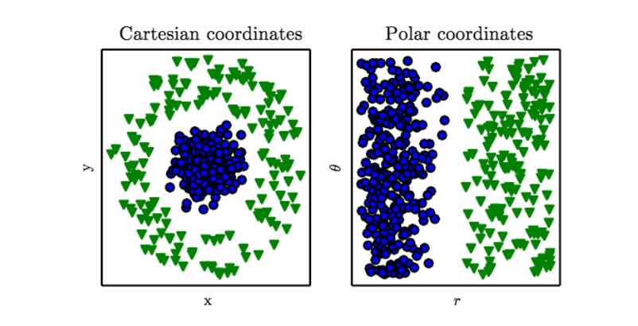
Data Representation & Feature Extraction

Slide 4
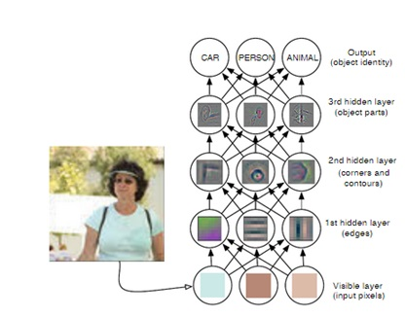
Deep Learning Model

Slide 5
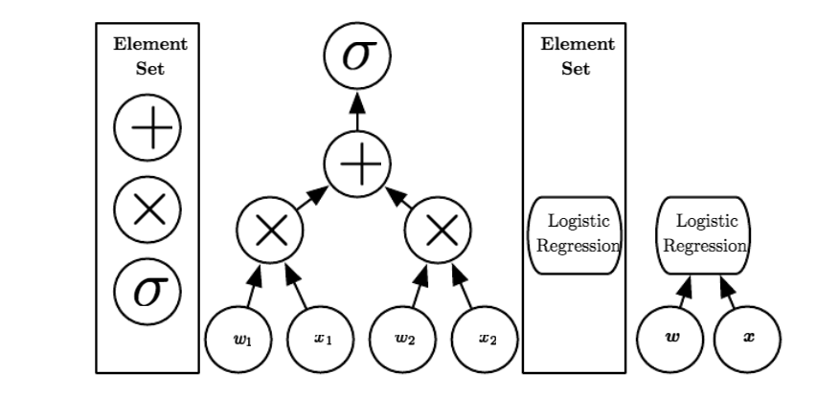
Computational Graph

Slide 6
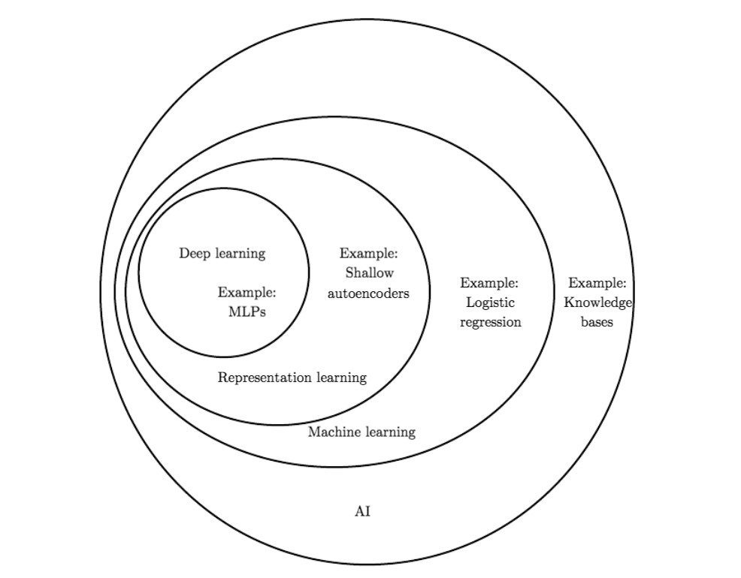

Slide 7
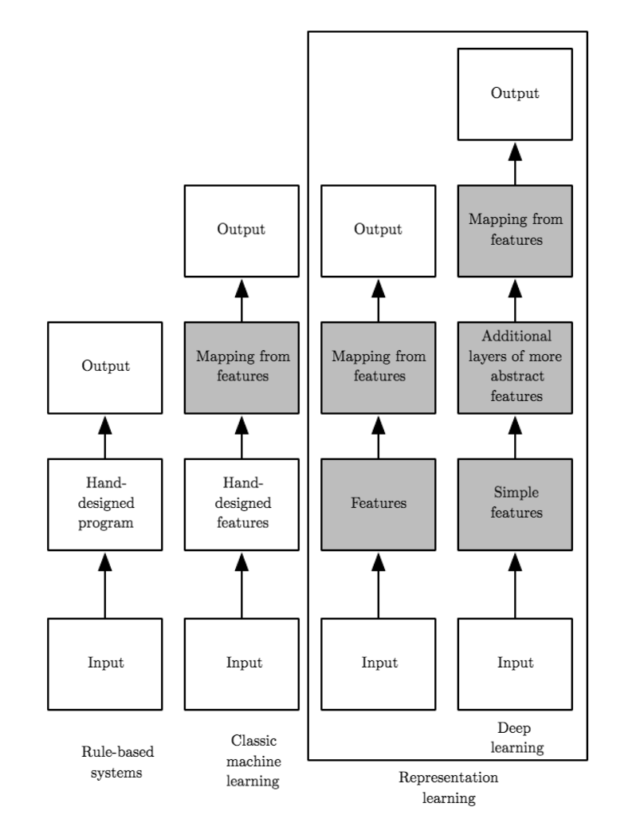

Slide 8
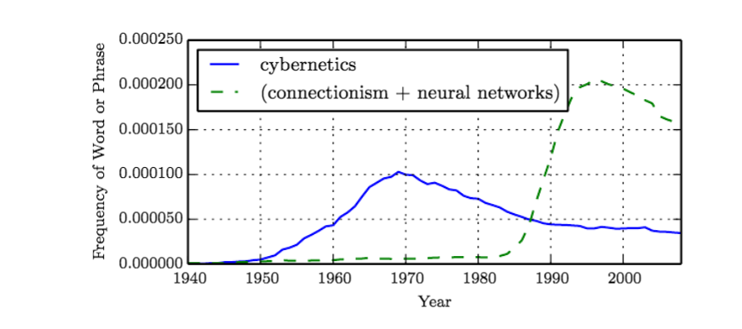
Historical Trends in Deep Learning
Notes:
Has had many names (MLPs)
Increased Training Data
Models increased in size as Infrastructure improves
Increase in complexity and accuracy of solutions for applications

Slide 9
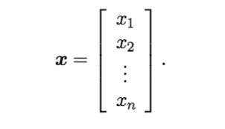
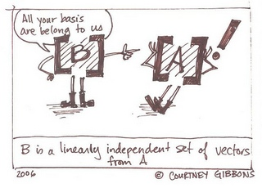
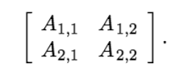
Chapter 2 - Linear Algebra
Scalar - single number
Vector - array of numbers arranged in order
Matrix - 2D array of numbers
Tensors - array with 3 or more axis

Slide 10
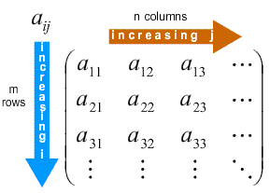
Identifying Matrices
A ∈ R^{m×n}
A_{m,n}
A_{i,:}
f(A)_{i,j}
Notes:
A ∈ R^{m×n} - has a height of m & width of n
A_{m,n} - bottom right entry of matrix
A_{i,:} - i-th row of A
f(A)_{i,j} - gives element (i,j) of the matrix computed by applying the function f to A

Slide 11
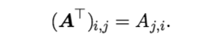
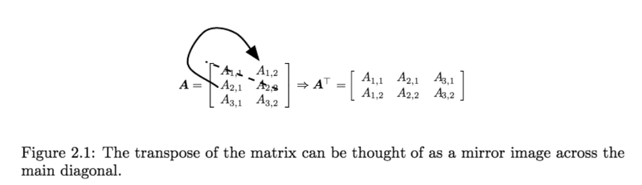
Transposing Matrices

Slide 12
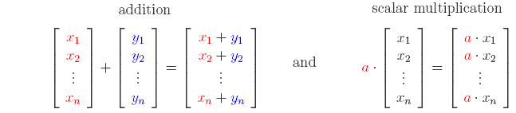
Matrix Addition

Slide 13
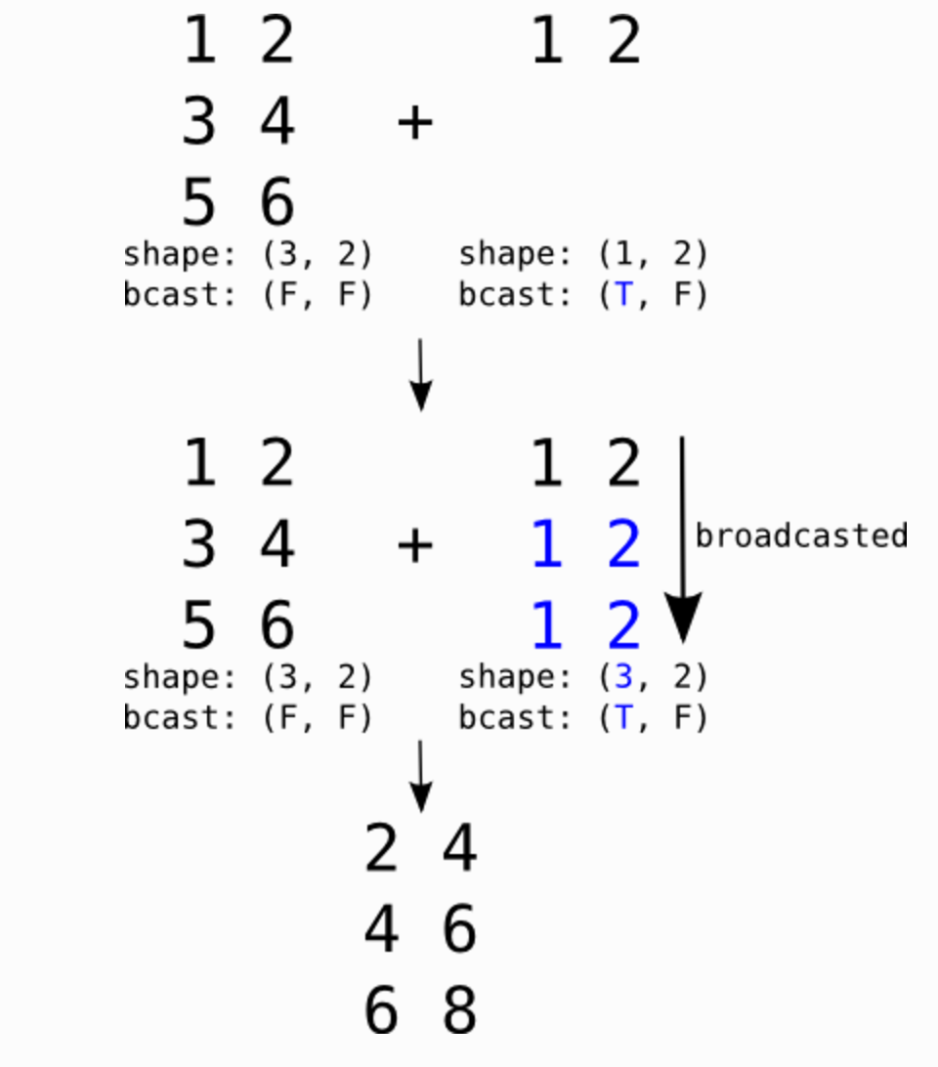
Broadcasting
Broadcasting a row matrix. T and F respectively stand for True and False and indicate along which dimensions we allow broadcasting.

Slide 14
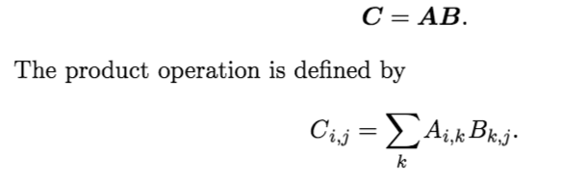
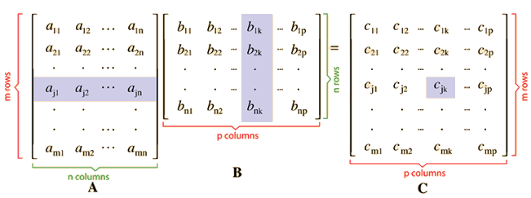
Matrix Product

Slide 15
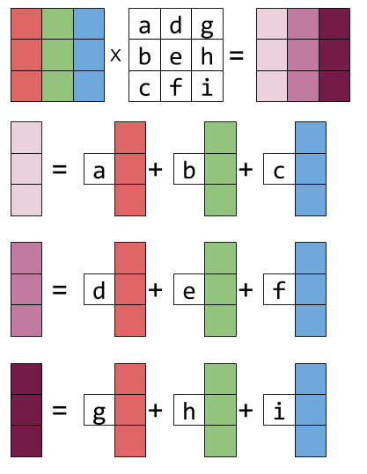
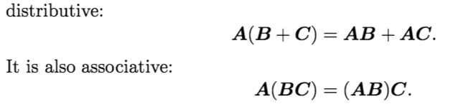
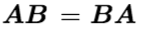
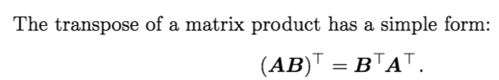
Matrix Product Properties

Slide 16
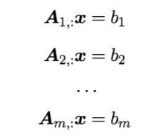
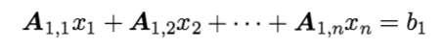
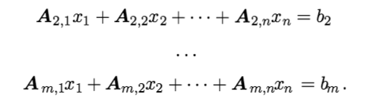
System of Linear Equations
Ax = b
A ∈ R^{m×n} - known matrix
b ∈ R^{m} - known vector
x ∈ R^{n} - vector to solve for (unknown variables)

Slide 17
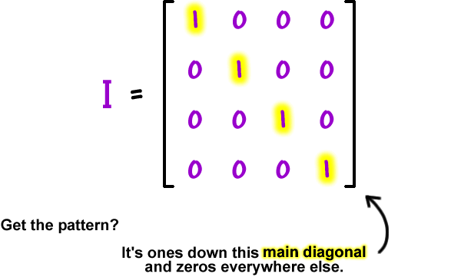
Identity Matrix

Slide 18
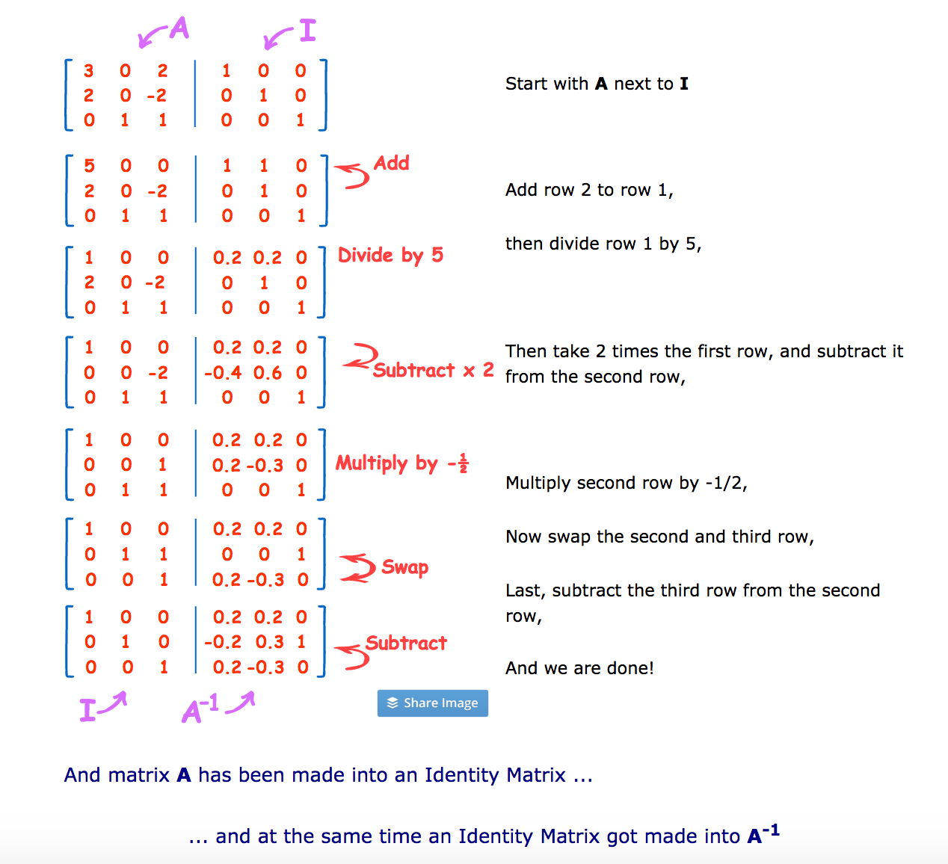
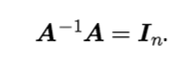
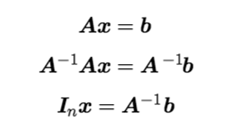
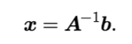
Inverse Matrices
Notes:
https://www.mathsisfun.com/algebra/matrix-inverse-row-operations-gauss-jordan.html

Slide 19
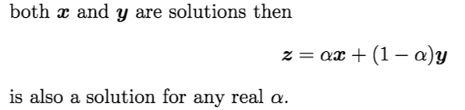

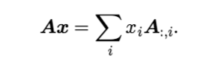
Span
Notes:
-The span of a set of vectors is the set of all points obtainable by linear combination of the original vectors.

Slide 20
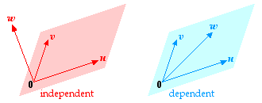
Linear Dependence vs Linear Independence

Slide 21
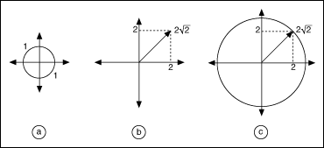
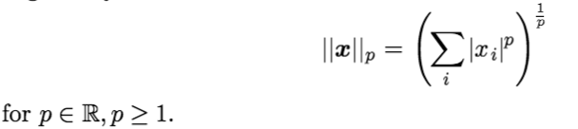
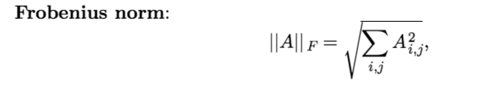
Norms - Measures the size of a vector.

Slide 22
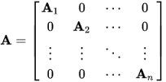
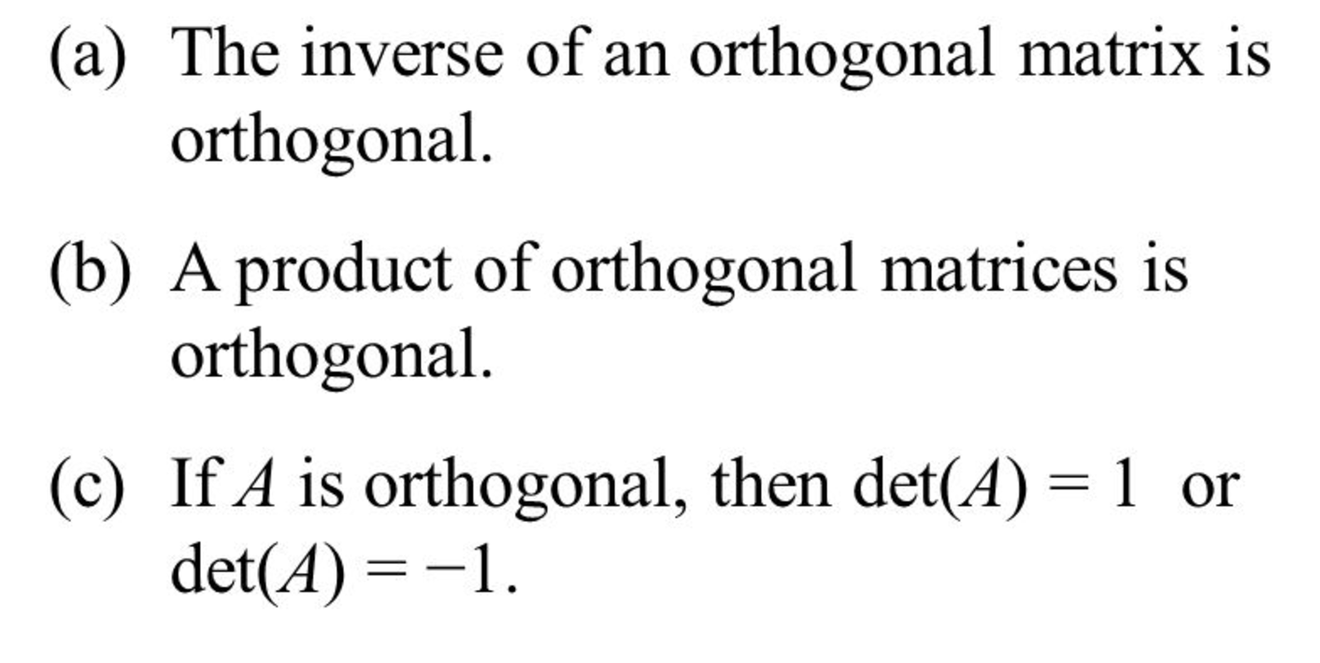
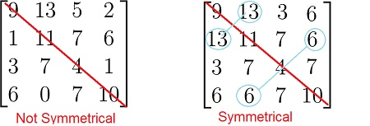
Special Matrices
Diagonal
Symmetric
Orthonormal
Notes:
Orthonormal - transpose and inverse must be the same

Slide 23
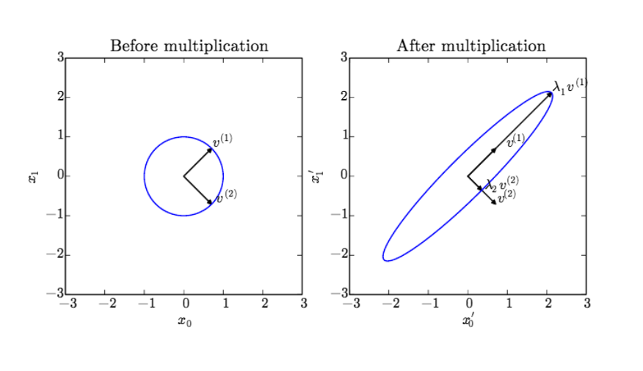
Eigendecomposition

Slide 24
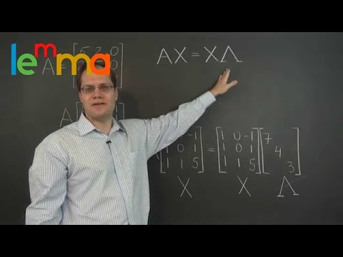
Tutorial Video

Slide 25

Singular Value Decomposition

Slide 26
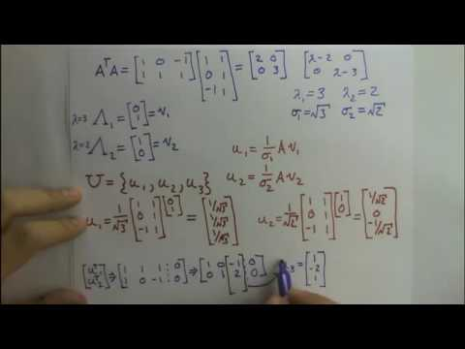
Tutorial Video

Slide 27
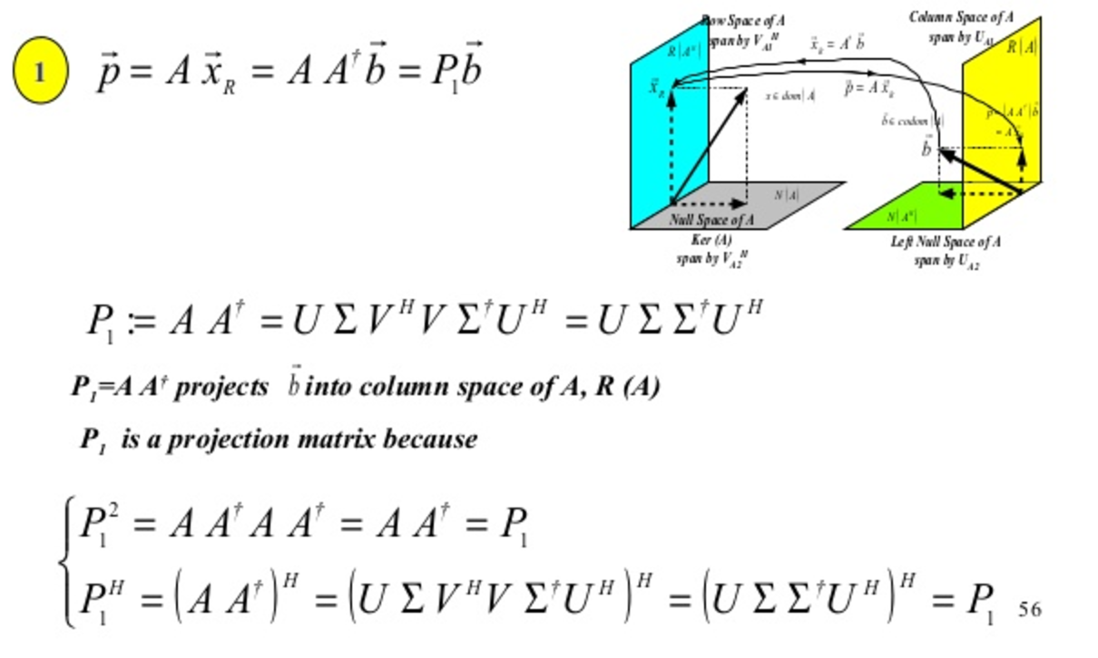
The Moore-Penrose Pseudoinverse

Slide 28
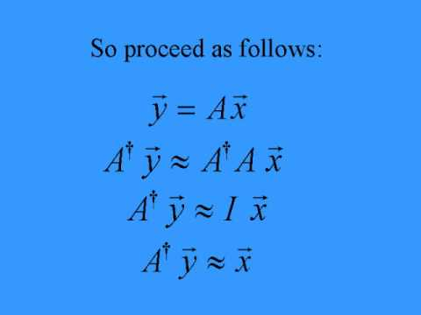
Tutorial Video

Slide 29
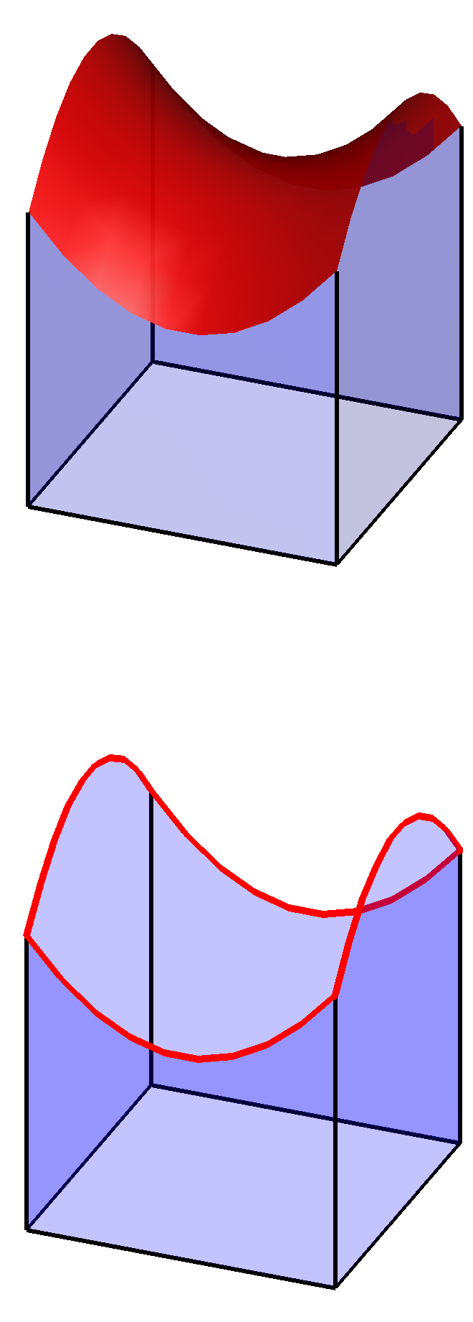
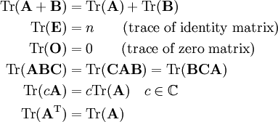
The Trace Operator

Slide 30
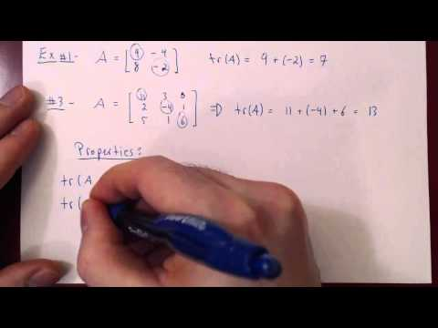
Tutorial Video

Slide 31
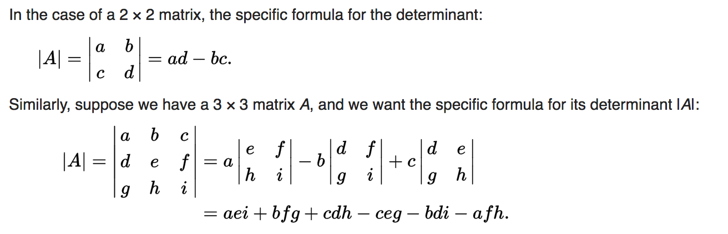
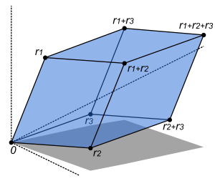
The Determinant

Slide 32
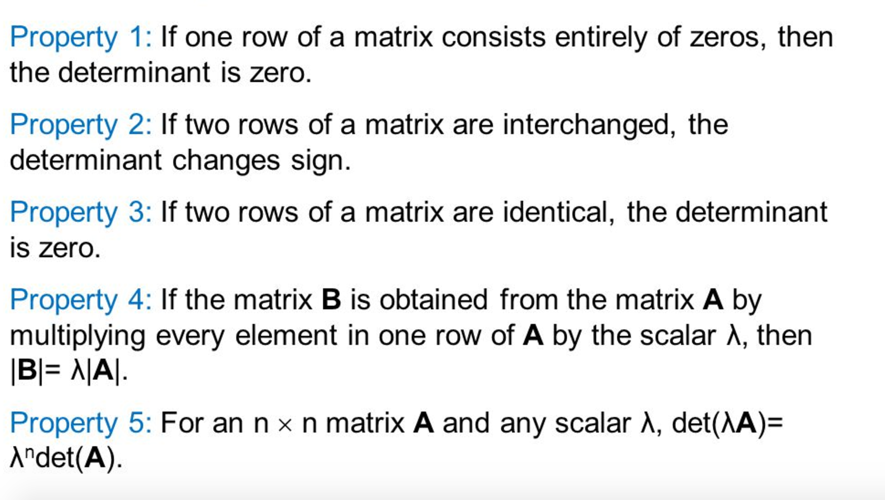
Properties of a Determinant

Slide 33
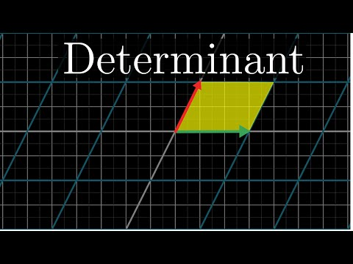
Tutorial Video

Slide 34
Additional Resources
Matrix Cookbook
Shilov Linear Algebra
Khan Academy Linear Algebra
Udacity Linear Algebra Refresher

